Slide 1
Air Quality in home
PETAR STOEV 9 A CLASS

Slide 2
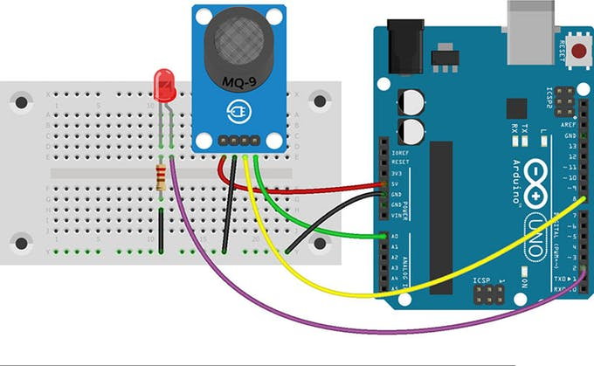
Composition of the project
Air cleaning sensor
Fan
Arduino trolley
Method of connecting the sensor →

Slide 3
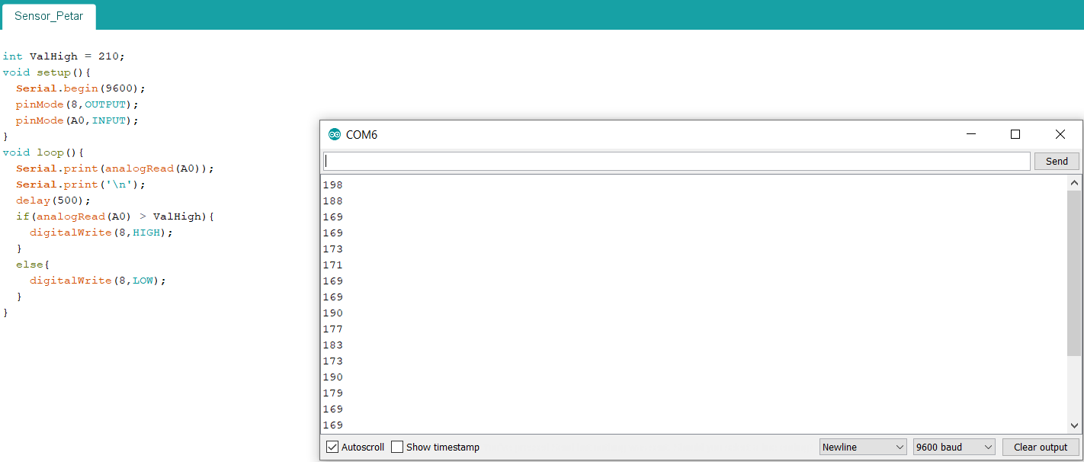
Technologies used
Arduino programming
2 cards
Zumo trolley
Contaminated air sensor
Sensor code ->

Slide 4
Problems and difficulties with the project
The main problem with my project was with the electricity I couldn’t provide enough electricity to keep the blower and the sensor alive.

Slide 5
In conclusion
There is a lot more to develop on this project and in my opinion if I develop it more It can become very profitable articule with a lot of sales.

Slide 6
Thank you for your attention!!!
Petar Krasimirov Stoev 9 a class
Pkstoev18@codingburgas.bg

